Slide 1

Fine-Tuning Models Part 9

Slide 2
What We Will Cover
Understanding Pre-Training
Understanding Fine-Tuning
When to Use Fine-Tuning
Preparing Training Data
Cost Calculations
Train / Test Split
Creating Fine-Tuning Jobs
Revisiting Hyperparameters
Analyzing the Training Metrics
Integrations
Exploring Fine-Tuning Jobs
Understanding Checkpoints
Exploring Fine-Tuning Events
Using Fine-Tuned Models
Fine-Tuning Use Cases
Continued Fine-Tuning
Practical Example

Slide 3
Practical Example

Slide 4
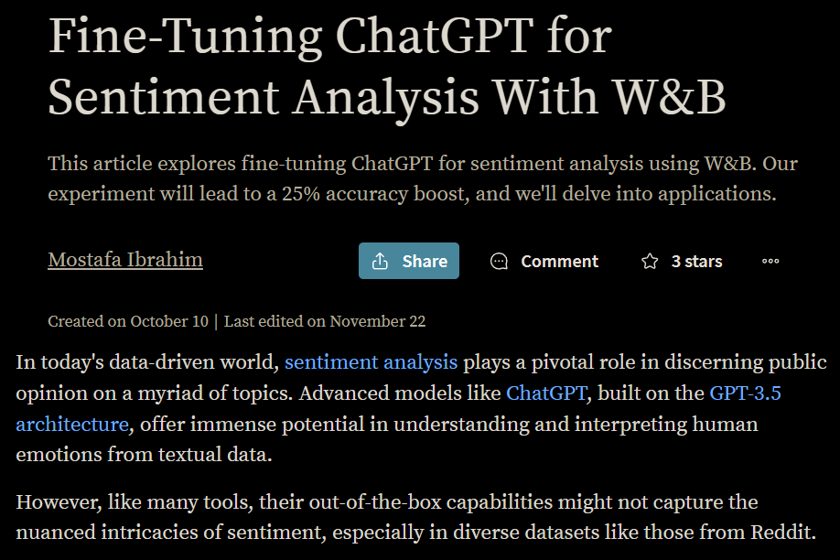
Notes:
https://wandb.ai/mostafaibrahim17/ml-articles/reports/Fine-Tuning-ChatGPT-for-Sentiment-Analysis-With-W-B--Vmlldzo1NjMzMjQx

Slide 5



Notes:
https://www.youtube.com/channel/UC35ZpwldGw7ZJ5R-2sLijzw

Slide 6
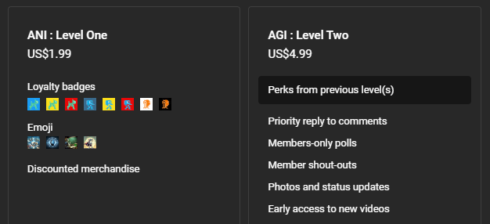
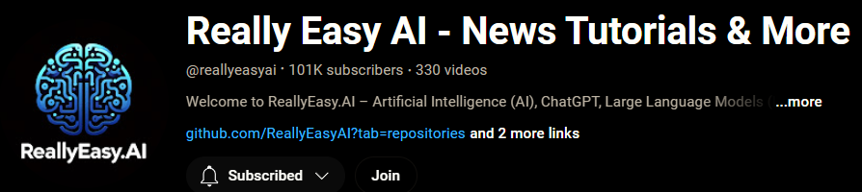
Membership has its privileges
Notes:
https://www.youtube.com/channel/UC35ZpwldGw7ZJ5R-2sLijzw/join

Slide 7

https://www.youtube.com/@AINewsFresh

Slide 8


